Slide 1
Attendance Administrator
BY Mohd Abdul Raheem
Mohd Afzal Khan
Sabeel Ur Rahman

Slide 2
Contents
S.No Description
1 INTRODUCTION
2 HARDWARE AND SOFTWARE Requirements
3 PRESENT SYSTEM
4 DRAWBACKS OF PRESENT SYSTEM
5 PROPOSED SYSTEM
6 ADVANTAGES OF PROPOSED SYSTEM
7 ARCHITECTURE
8 FLOWCHART
9 TECHNOLOGIES
10 CONCLUSION
11 FUTURE ENHANCEMENT
12 RESULT

Slide 3
What is Attendance?
the action or state of going regularly to or being present at a place or event.

Slide 4
Introduction
TO save time and lessen the human efforts .Humans are evolving day-by-day and emerging with new technologies
But still we are not modernized when it comes to maintaining records such as attendance.
So this is where “Attendance Administrator” comes in the picture

Slide 5
Hardware Requirements
Computer 386 and upward for better Efficient performance
Power Required 63.5watt
CPU 80386 and upward
CPU clock speed processor Compatible(up to 66 MHZ
Memory size: 1gb on system board
Mass storage Device: 50gb
Keyboard Up to 105keys
Monitor: VGA or(SVGA\Color)

Slide 6
Software Requirements
Operating system:-Windows Xp or Above.
Web browser:-opera, chrome…etc
Connection to Server Wireless or Wired.

Slide 7
Present System
Basically the attendance is maintained by using traditional methods
i.e. “Pen and Paper”
It is more time consuming and requires a lot of human efforts and the records are worn out by the passage of time
As traditional method uses pen and paper which are produced causing damage to the nature

Slide 8
Draw Backs of Present System
In Efficient
Causes damage to Nature
Time Consuming

Slide 9
Proposed System
It is basically a website based application with user friendly interface
The interface is in the design of web forms that accepts the user input
It requires minimum configurative System to support the website

Slide 10
Advantages of Proposed System
User Friendly Interface
Less time consuming and more efficient
Data is handled by the system i.e. less errors

Slide 11
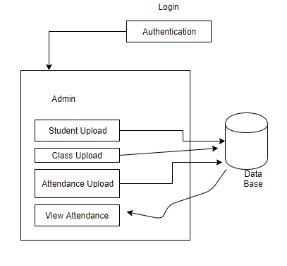
Architecture

Slide 12
Technologies Used
HTML , Css , C#(pronounced as C-Sharp) using Asp. Net, SQL
HTML,CSS
For the View
C# for Logic Implementation
Sql for interaction with database

Slide 13
Software's Used
Visual Studio for Coding the Project
Brackets for Designing the Web pages
Structured Query Language Data base for Storing and Retrieving data

Slide 14
Lets View the project

Slide 15
Conclusion
Here by we would like to conclude that this after designing and coding the project we came to conclusion that this project helps an individual maintain the attendance record Digitally with ease and convenience

Slide 16
Future Enhancements
We can also add more information of students apart from attendance like their internal assessment marks and much more.
We could also include the features like biometric method with its own hardware that would allow the users to imply their appearance which not only increases the efficiency and lessens the efforts of the administrator
The retina scanning could also be included for more security which would ensure no amount of manipulation.

Slide 17
Result
By following our web application the Administrator could easily insert and retrieve the records from the data Base

Slide 18

Thank You

